Slide 1

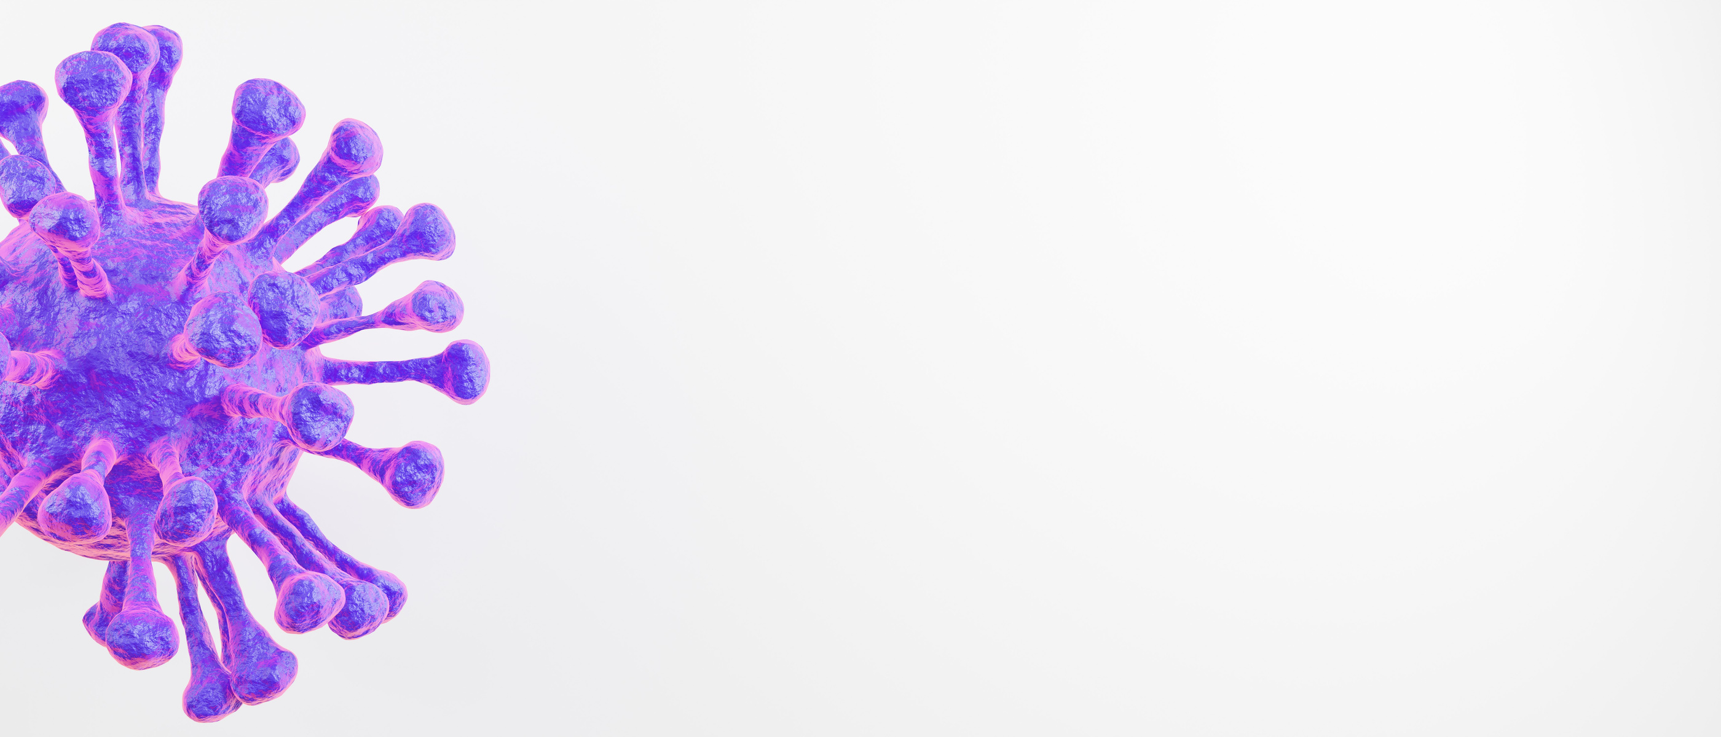


PNEUMONIA DETECTION USING CNN
(CONVOLUTIONAL NEURAL NETWORK)
SCHOOL OF COMPUTER ENGINEERING
BHUBANESWAR, ODISHA - 751024
May 2020
KALINGA INSTITUTE OF INDUSTRIAL TECHNOLOGY

Slide 2
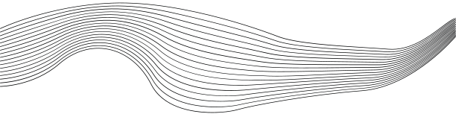

CONTENT
01
INTRODUCTION
02
PROJECT VISION AND MISSION
03
CNN(CONVOLUTIONAL NEURAL NETWORK)
04
YOLOV9
05
IMPLEMENTATION
06
RESULT
07
CONCLUSION

Slide 3





Innovating Healthcare Diagnostics: Revolutionizing healthcare diagnostics through advanced CNN technology for pneumonia detection, improving patient outcomes globally.
01.
Project vision and mission
AI Algorithm Development: Develop and refine CNN algorithms for precise and early pneumonia detection from chest X-rays.
02.
Revolutionizing healthcare diagnostics globally through advanced CNN technology for precise pneumonia detection from chest X-rays. Mission: Develop and rigorously validate CNN algorithms in collaboration with healthcare professionals, ensuring seamless integration into clinical practice for improved patient outcomes.
Rigorous Validation and Collaboration: Ensure rigorous testing and collaborate with healthcare professionals to integrate our technology seamlessly into clinical practice, ensuring safety and effectiveness.
03.

Slide 4
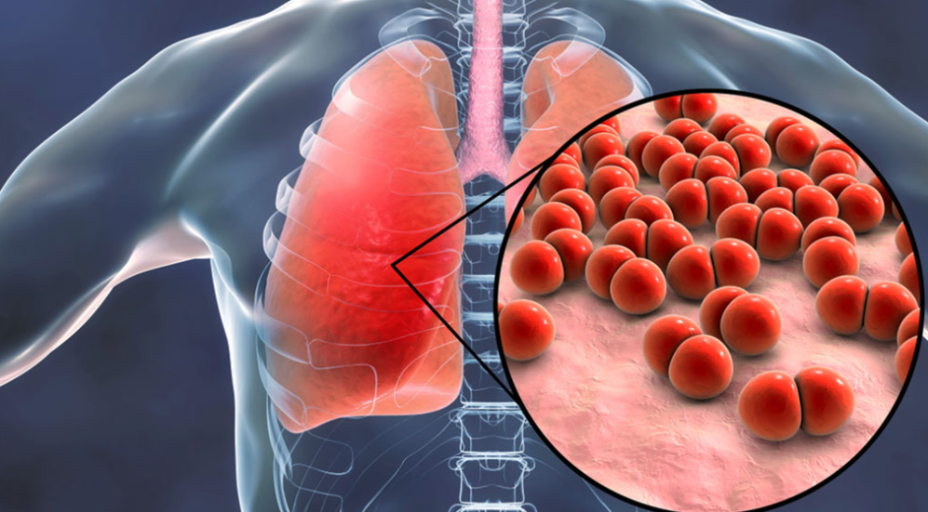
Pneumonia
A Serious Threat
Pneumonia is an infection that inflames the air sacs in the lungs, making breathing difficult. It's a leading cause of death in children under five worldwide and a serious illness for adults as well. Early detection and treatment are crucial for successful recovery.
Chest X-rays and Diagnostic Challenges
Chest X-rays are a common tool for diagnosing pneumonia. However, traditional methods rely on radiologists' expertise, which can be:
Time-consuming: Analyzing X-rays can be a lengthy process.
Subjective: Interpretations may vary between radiologists.
Convolutional Neural Networks: A Powerful Ally
Convolutional Neural Networks (CNNs) are a type of artificial intelligence (AI) particularly adept at image analysis. They have the potential to revolutionize pneumonia detection by:
Improving Efficiency: CNNs can automate some of the analysis, freeing up radiologists' time.
Enhancing Accuracy: By learning subtle patterns in X-rays, CNNs may identify pneumonia missed by the human eye.
Increasing Accessibility: AI-based systems could be deployed in areas with limited access to healthcare professionals.

Slide 5
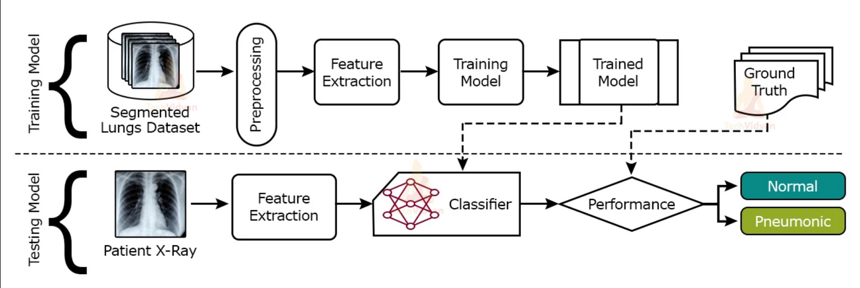
CNN
Convolutional Neural Network, is a type of artificial neural network specifically designed for processing structured grid data. It's particularly powerful for tasks like image recognition and classification.
Convolutional Layer: This is the core building block of a CNN. It applies convolution operation to the input, which involves sliding a filter (also known as a kernel) over the input data, element-wise multiplying the filter values with the input values, and summing up the results to produce a feature map. This operation helps in capturing spatial hierarchies of patterns in the input data.
Activation Function: After each convolution operation, a non-linear activation function such as ReLU (Rectified Linear Unit) is applied element-wise to introduce non-linearity into the network, allowing it to learn complex patterns.

Slide 6
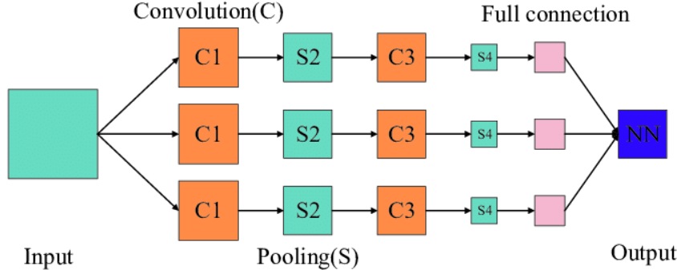
Pooling Layer: Pooling layers are used to reduce the spatial dimensions of the feature maps while retaining important information. Common pooling operations include max pooling and average pooling, which downsample the feature maps by taking the maximum or average value within a small region.
Fully Connected Layer: After several convolutional and pooling layers, the high-level reasoning in the neural network is done via fully connected layers. These layers connect every neuron in one layer to every neuron in the next layer, allowing the network to learn complex patterns.
Output Layer: The final layer of the CNN produces the output of the network. For classification tasks, this layer often consists of one or more neurons with activation functions such as softmax, producing probabilities for each class.

Slide 7
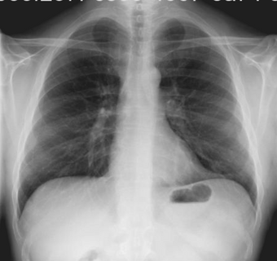
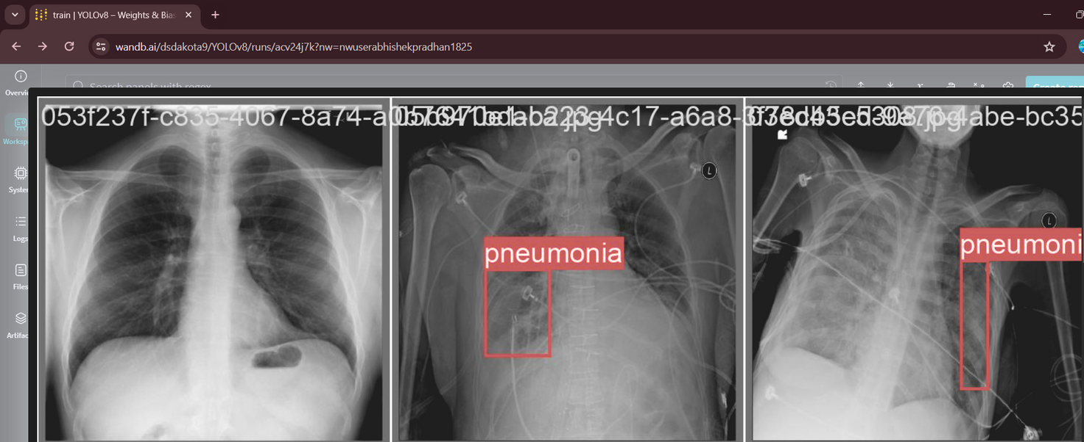
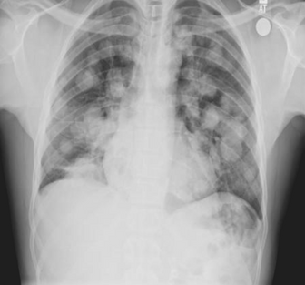
YoloV9 for object detection
Input
Chest X-ray
t
Output
Pneumonia Present
Output
Pneumonia Present
Input
Chest X-ray
NO
YES

Slide 8

Project Planning
Data Source: The dataset used for this project is the RSNA Pneumonia Detection Challenge dataset.
Tasks:
1. Data preprocessing: The first step is to load the DICOM images, convert them to JPEG format, and generate the corresponding labels.
2. Dataset creation: The dataset needs to be divided into three subsets: train, validation, and test sets.
3. Model setup: Initialize and configure the YOLOv9 model for the pneumonia detection task.
4. Training: Train the YOLOv9 model using the training data.
5. Evaluation: Assess the performance of the trained model on the validation set.
6. Deployment: Save the trained model for future use.
.JPEG
.DICOM

Slide 9

YOLOv9, an evolution of the YOLO (You Only Look Once) object detection algorithm, offers state-of-the-art performance in real-time object detection. With its efficient architecture, YOLOv9 enables accurate and rapid detection of pneumonia indications in chest X-ray images, enhancing diagnostic capabilities in our project.
YOLOv8, like its predecessors, is a Convolutional Neural Network (CNN)-based object detection algorithm. It utilizes CNN layers to extract features from input images and predicts bounding boxes and class probabilities for objects within those images. This enables efficient and accurate object detection in real-time applications.

Slide 10

1024
Pixels
The script sets image size to 1024 pixels. It defines paths for RSNA pneumonia dataset images and the destination folder for processed data.

Slide 11
Project Analysis:
Data Analysis:
- Explore the statistics of the dataset, such as the number of samples and the distribution of classes.
- Visualize the data distributions and the annotations of the labels.
System Design:
Data Processing:
- Convert the DICOM images to the JPEG format to facilitate further processing.
- Generate bounding box annotations for the training process.
Model Selection:
- Choose the YOLOv9 architecture as the model of choice for object detection.
Training Pipeline:
- Define the training configuration, including parameters such as the number of epochs and the learning rate.
- Implement the training loop, ensuring to save checkpoints during the process.
Validation Pipeline:
- Evaluate the model's performance on a separate validation set to assess its effectiveness in detecting pneumonia.

Slide 12
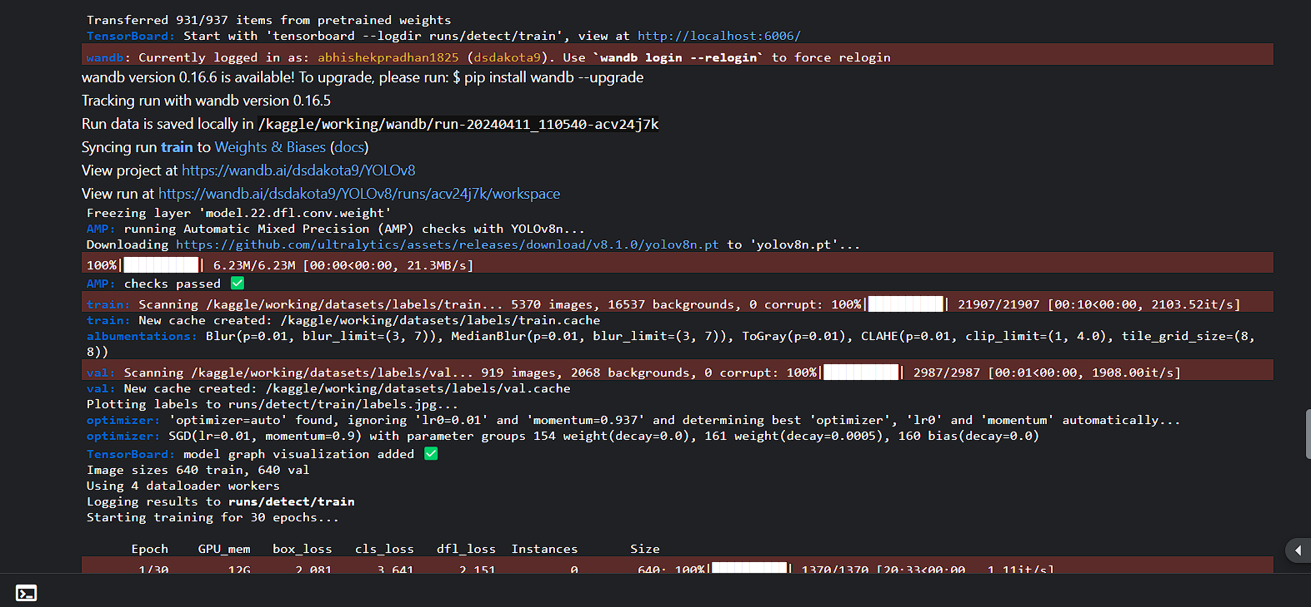
The provided code initializes a YOLOv9 model using a pre-trained checkpoint. It logs into Weights & Biases for experiment tracking. The model is trained for 30 epochs, with periodic checkpoint saving. After training, the final model is saved as "final_yolov9.pt".

Slide 13
The program is tracking the run with wandb version 0.16.5.
The program is freezing the layer 'model.22.dfl.conv.weight".
The program is downloading the file 'yolov8n.pt' from the internet.
The program is scanning the directories /kaggle/working/datasets/labels/train and /kaggle/working/datasets/labels/val.
The program is plotting labels to runs/detect/train/labels.jpg.
The program is using an SGD optimizer with a learning rate of 0.01 and a momentum of 0.9.
The program is training for 30 epochs.

Slide 14
Wandb, short for
Weights & Biases,
is a machine learning experiment tracking and visualization platform. It's relevant to the above project as it enables researchers to monitor and analyze the training process of CNN models such as YOLOv8 or YOLOv9 for pneumonia detection. With wandb, researchers can track model performance metrics, visualize training progress, and collaborate effectively to improve model accuracy and efficiency.
What
is
wandb?

Slide 15
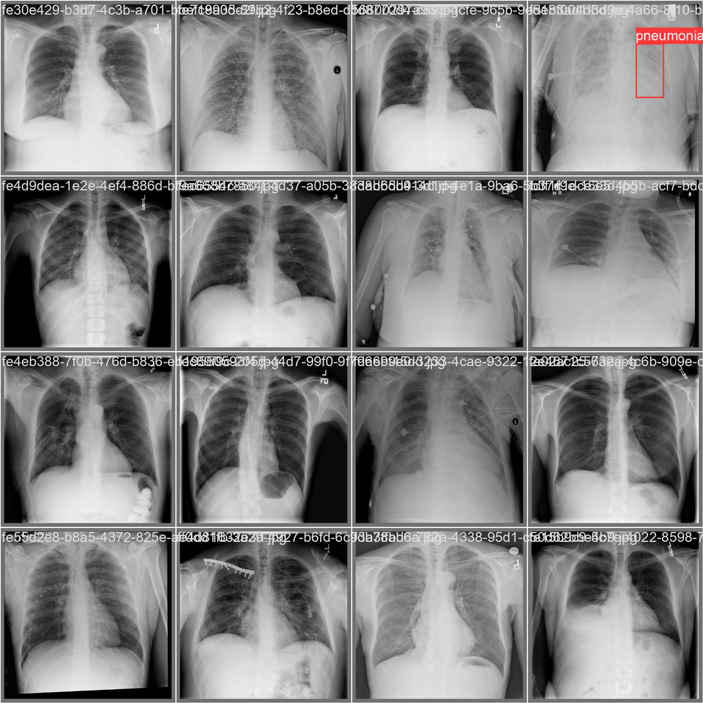
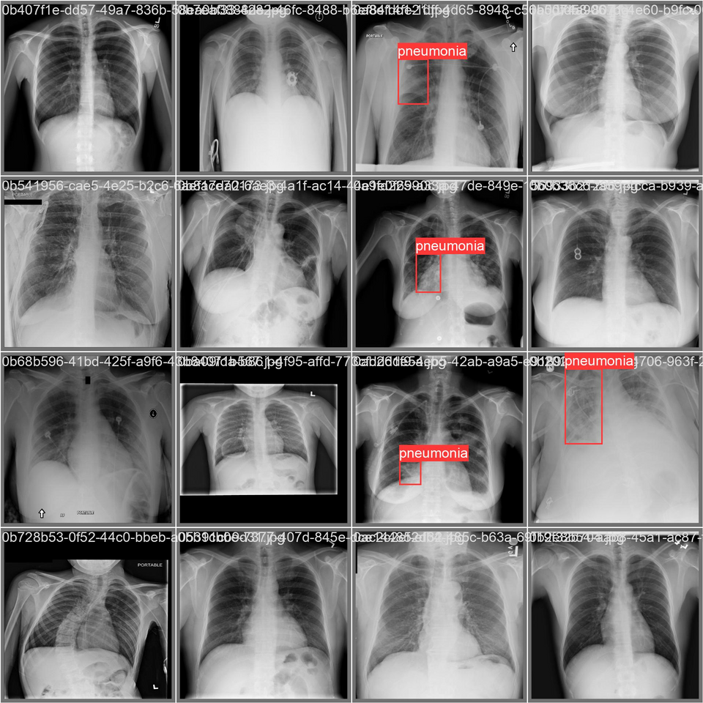
A bounding box, often abbreviated as bbox, is a rectangular frame drawn around an object in an image to indicate its location and size. In object detection tasks, bounding boxes are used to identify and localize objects within images.

Slide 16
OUR TEAM
1. Abhishek Pradhan - 21053453
2. Aditya Pandey - 21053359
3. Pratham Mishra - 21052854
4. Ratnaabh Singh - 21051587
5. Ankit kumar - 2105179

Slide 17
Conclusion & future scope
Utilizing a CNN, we successfully trained a model for pneumonia detection in chest X-ray images. Achievements include tailored CNN architecture design, model training, and evaluation. This project highlights the potential impact of automated pneumonia detection, paving the way for future improvements and real-world deployment.

